Slide 1


How You Get Cricket Score Update?

Slide 2


Slide 3
BallTracker Provide Live Cricket Score With Ball Marking System

Slide 4


Team
MD. Tahsin Ahammod
Programmer
MD. Raj Fokir
Designer
Kazi Zahurul Haque College

Slide 5
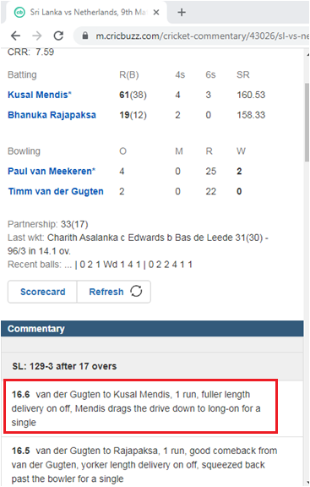
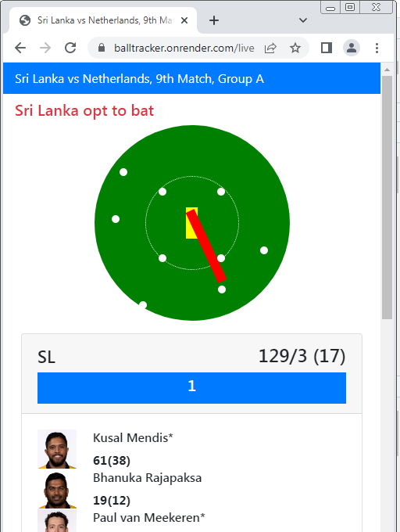
CricBuzz And Other Apps
BallTracker
Other Apps Provide Text
Commentry
Ball Tracker Provide Visual Animation

Slide 6
User Behaviour
Mass Consumer
Youtube Commentetor
Not Looking For
Not Giving Any Feedback
Non-Technical
Not Interested To Use Crappy MVP
Desperate
Giving Feature Request
A Bit Technical
Willing To Use Crappy MVP

Slide 7



Tech Stack
Server Database Cloud Anlaytical | NodeJS MongoDB Render Google Analytics,Fullstory

Slide 8
Market
2 B+
300 M+
2 M+
Potential User
Active User
Desperate User

Slide 9
Traction

